Slide 1
Fake News Detection
Machine Learning Project
By Harsh Kumar Singh

Slide 2

Context of the Project
Lots of things you read online especially in your social media feeds may appear to be true, often is not. False information is news, stories or hoaxes created to deliberately misinform or deceive readers. Usually, these stories are created to either influence people’s views, push a political agenda or cause confusion and can often be a profitable business for online publishers. False information can deceive people by looking like trusted websites or using similar names and web addresses to reputable news organizations.

Slide 3
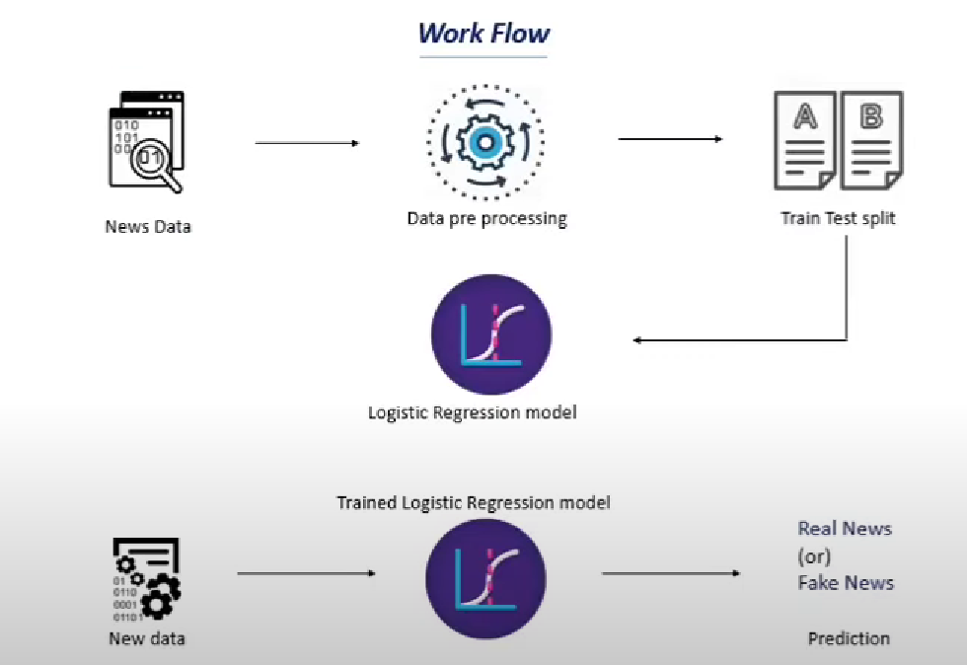
Work Flow of the Project

Slide 4
Machine Learning Algorithm Used
Logistic Regression -
Logistic regression is a supervised classification is unique Machine Learning algorithms in Python that finds its use in estimating discrete values like 0/1, yes/no, and true/false. This is based on a given set of independent variables. We use a logistic function to predict the probability of an event and this gives us an output between 0 and 1. Although it says ‘regression’, this is actually a classification algorithm. Logistic regression fits data into a logit function and is also called logit regression.

Slide 5
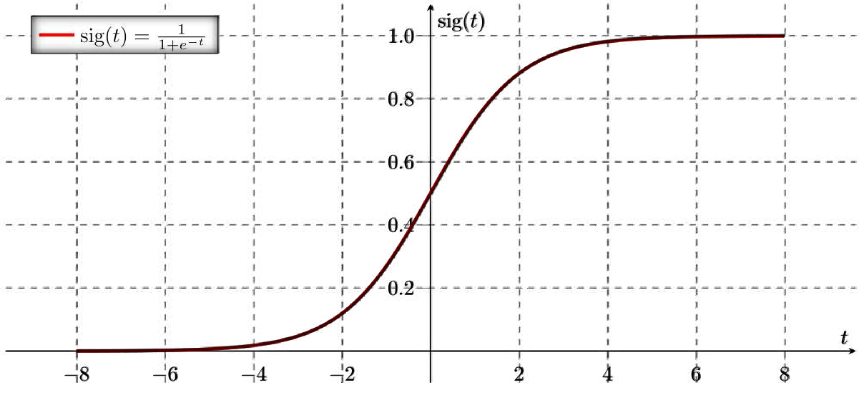
LOGISTIC REGRESSION
Figure shows Sigmoid Activation Function

Slide 6

Environment Used
If you have used Jupyter notebook previously, you would quickly learn to use Google Colab. To be precise, Colab is a free Jupyter notebook environment that runs entirely in the cloud. Most importantly, it does not require a setup and the notebooks that you create can be simultaneously edited by your team members - just the way you edit documents in Google Docs. Colab supports many popular machine learning libraries which can be easily loaded in your notebook.

Slide 7
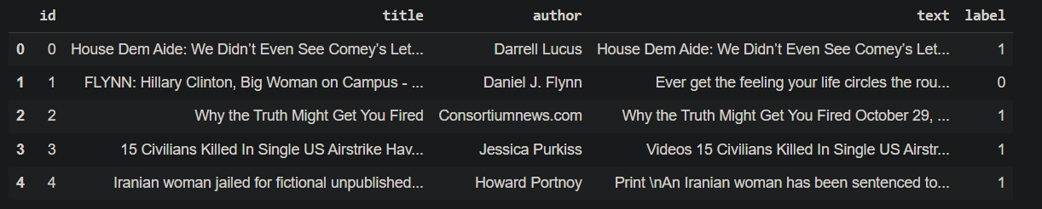
Dataset Description
About the Dataset: 1. id: unique id for a news article
2. title: the title of a news article
3. author: author of the news article
4. text: the text of the article; could be incomplete
5. label: a label that marks whether the news article is real or fake:
1: Fake news
0: real News
https://www.kaggle.com/c/fake-news/data?select=train.csv

Slide 8
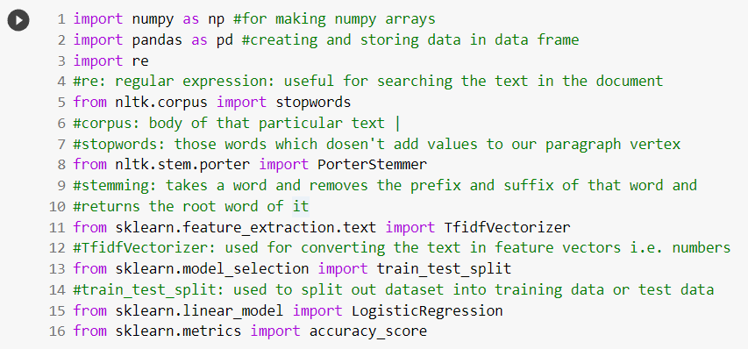
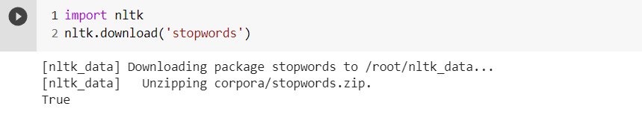
Importing the Dependecies

Slide 9
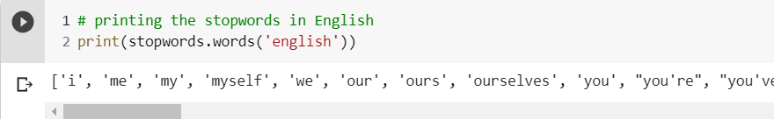
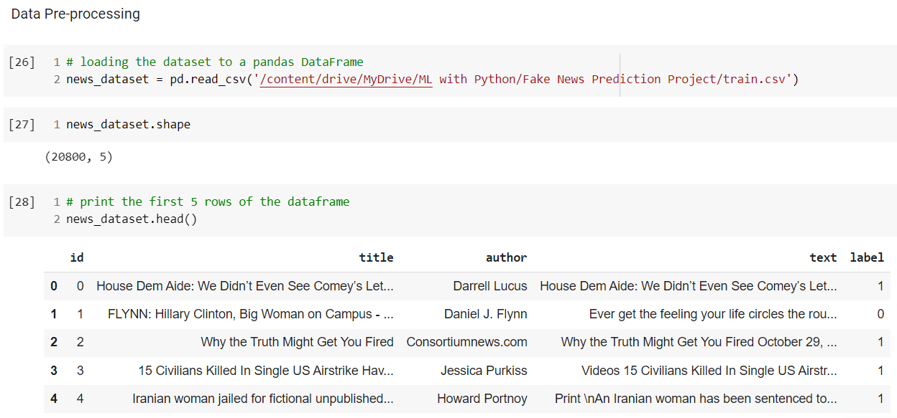
Data Pre-Processing

Slide 10
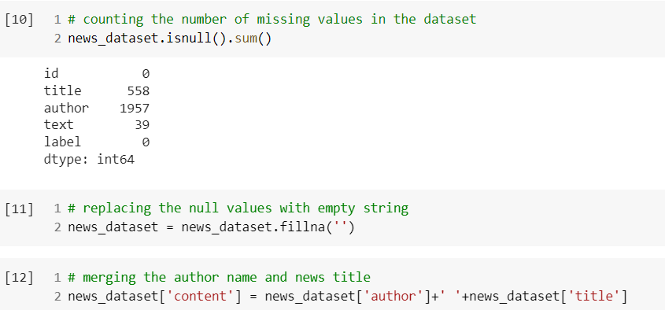
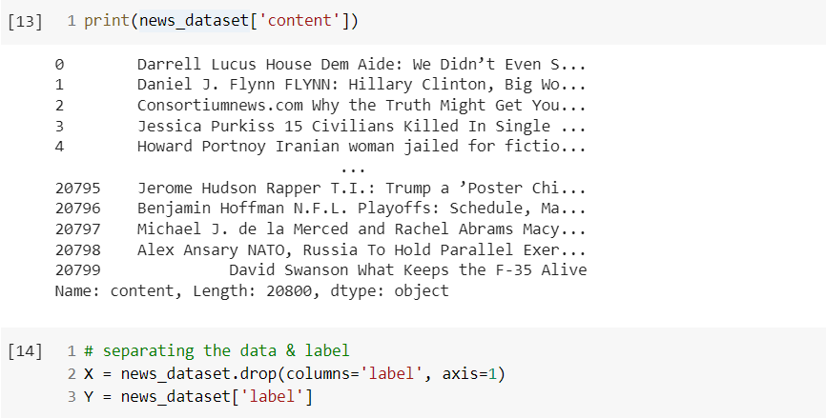
Data Pre-Processing

Slide 11
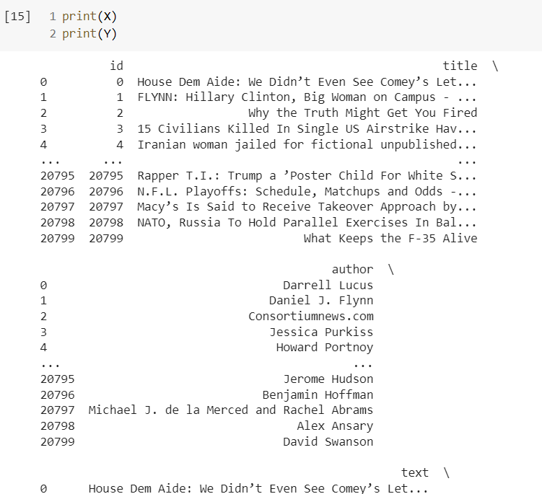
Data Pre-Processing

Slide 12
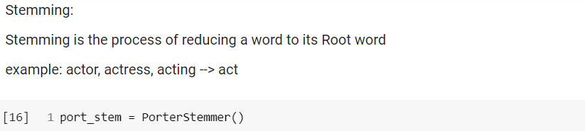
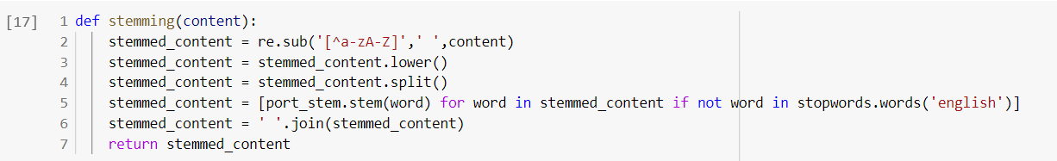
Stemming

Slide 13
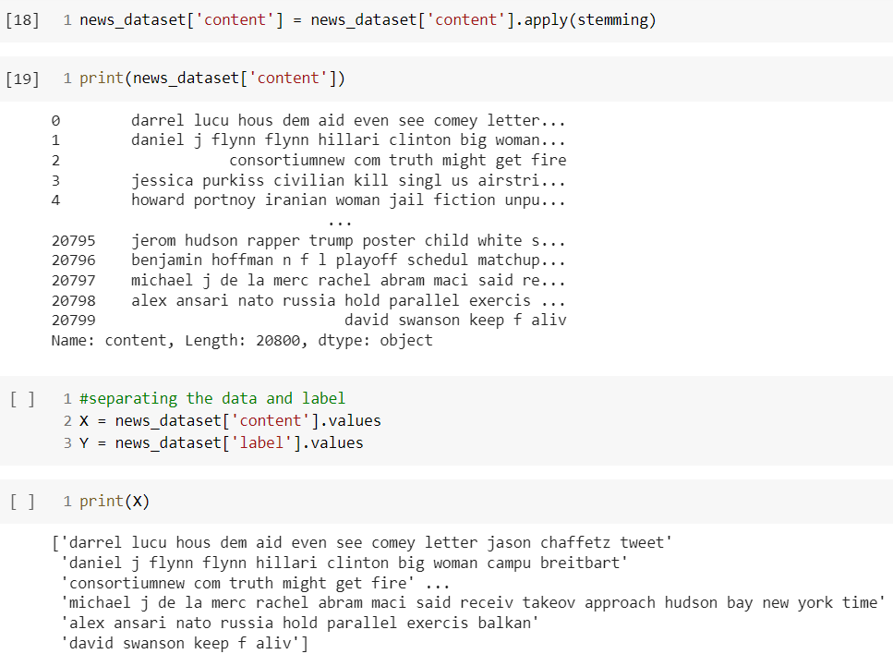

Slide 14
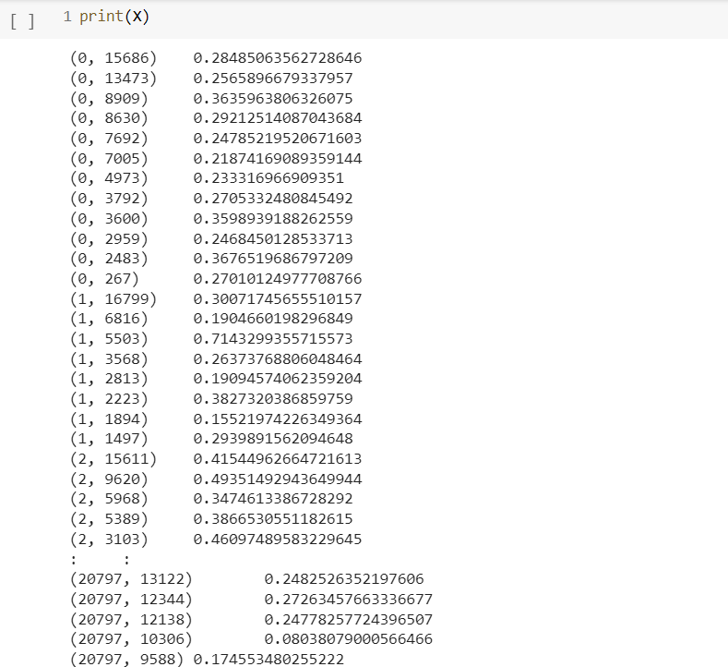
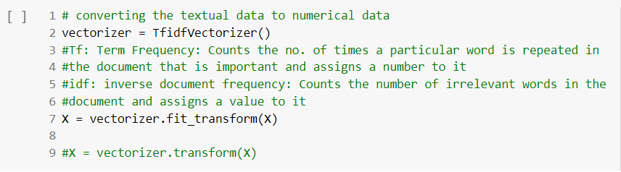
Conversion of Text to Numeral Data

Slide 15
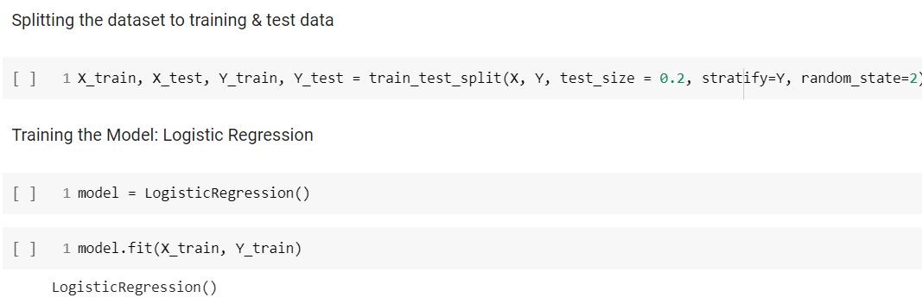
Splitting of Dataset

Slide 16
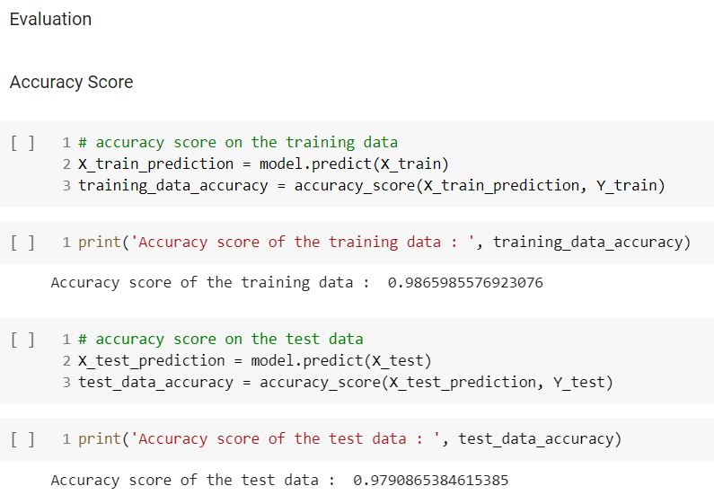
Accuracy Score

Slide 17
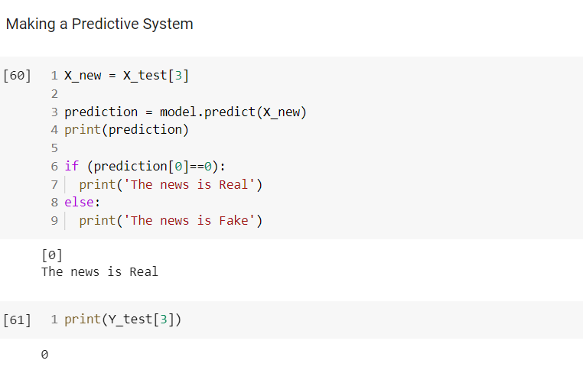
Predictive System

Slide 18
References and Link to Source Code
https://docs.python.org/3/contents.htm
https://www.tutorialspoint.com/machine_learning_with_python/machine_learning_with_python_quick_guide.htm
Link to Source Code:
https://colab.research.google.com/drive/1vzC7xJUBpVO9SbO_1T_tA4OszeXuesfv#scrollTo=_PXIMQ7zArJk

Slide 19
Thank You

